Slide 1
Automation Testing

Slide 2
What is testing?
Testing is widely used technology because it is compulsory to test each and every software before deployment.
Evaluating the execution of software components to find the software bugs or errors or defects.

Slide 3
Software testing
Software testing is a process of identifying the correctness of software by considering its all attributes (Reliability, Scalability, Portability, Re-usability, Usability) and evaluating the execution of software components to find the software bugs or errors or defects.

Slide 4
Functional Testing
Checks what the system does — its features and actions.
Unit Testing – tests small parts of code (like a single function).
Integration Testing – tests how different modules work together.
System Testing – tests the entire application as a whole.

Slide 5
2. Non-Functional Testing
Checks how well the system works — its quality, performance, and behavior under stress.
Performance Testing
To check how fast, responsive, and stable the system is under different conditions.
2. Load Testing
To test how the system behaves under expected user load.
3. Stress Testing
To check how the system performs under extreme conditions — beyond normal limits.

Slide 6
Commercial vs Open source
Commercial tool |  | Open-source tool
Commercial functional testing tools are those testing tools, which are not available freely in the market. |  | Open-source functional testing tools are those tools, which are available freely in the market.
These tools are also known as licensed tools. |  | These tools have less functionality and features than the commercial/licensed tools, but sometimes working on the commercial tool became an expensive process.
The licensed tools include various features and approaches as compared to the open-source tools. |  | That's why some well-known organizations preferred to use open-source tools.

Slide 7
Selenium

Slide 8
What is Selenium?
Selenium is one of the most widely used open source Web UI (User Interface) automation testing suite.
It was originally developed by Jason Huggins in 2004 as an internal tool at Thought Works.
Selenium supports automation across different browsers, platforms and programming languages.

Slide 9
Test Automation with Selenium:
open source testing tool
selenium used for web application testing
selenium support (chrome, firefox, Microsoft edge, safari, opera)
selenium support OS like(windows, Linux, apple os)
selenium support programming language(Java,Python,c#,PERL,R,Ruby)Python

Slide 10
Why learn Selenium Python ?
Open Source and Portable
Combination of tool and DSL(Domain Specific Language)
Easier to understand and implement
Less burden and stress for testers
Cost reduction for the Business Clients

Slide 11
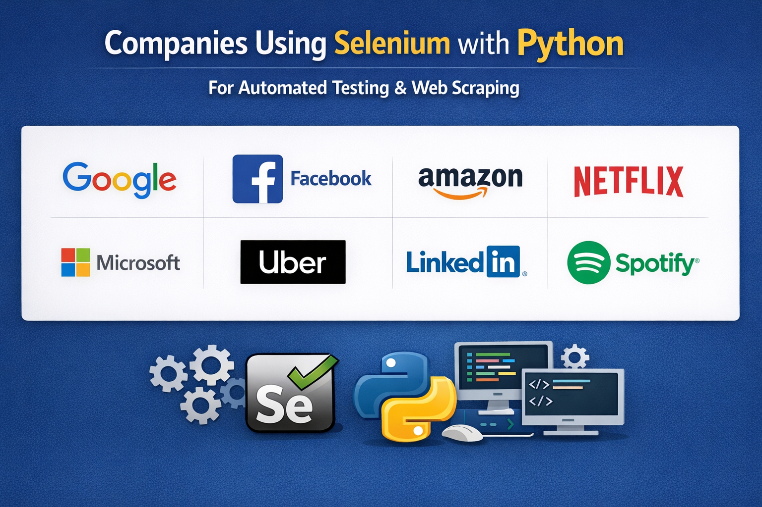

Slide 12
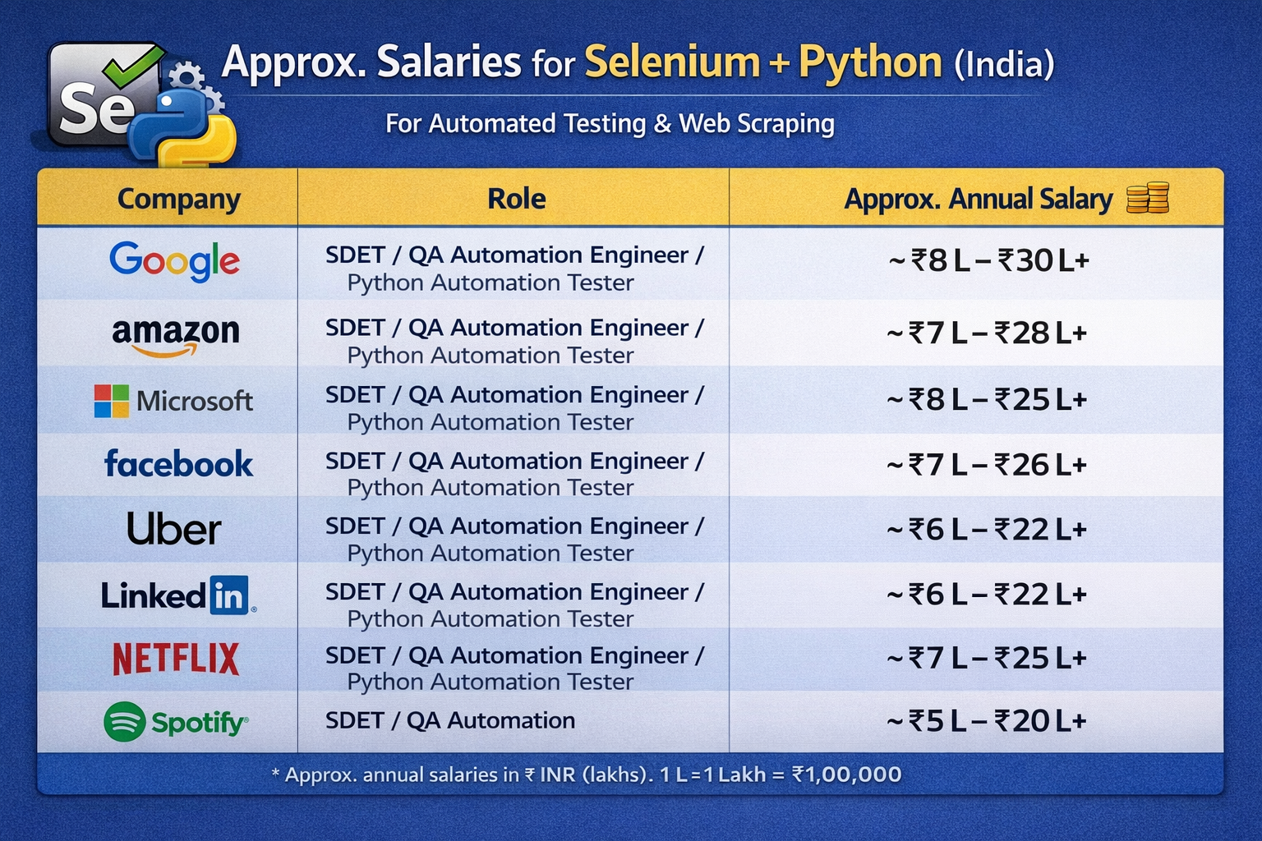

Slide 13
Selenium WebDriver Framework Architecture
WebDriver Architecture is made up of four major components:
Selenium Client library
JSON wire protocol over HTTP
Browser Drivers
Browsers

Slide 14
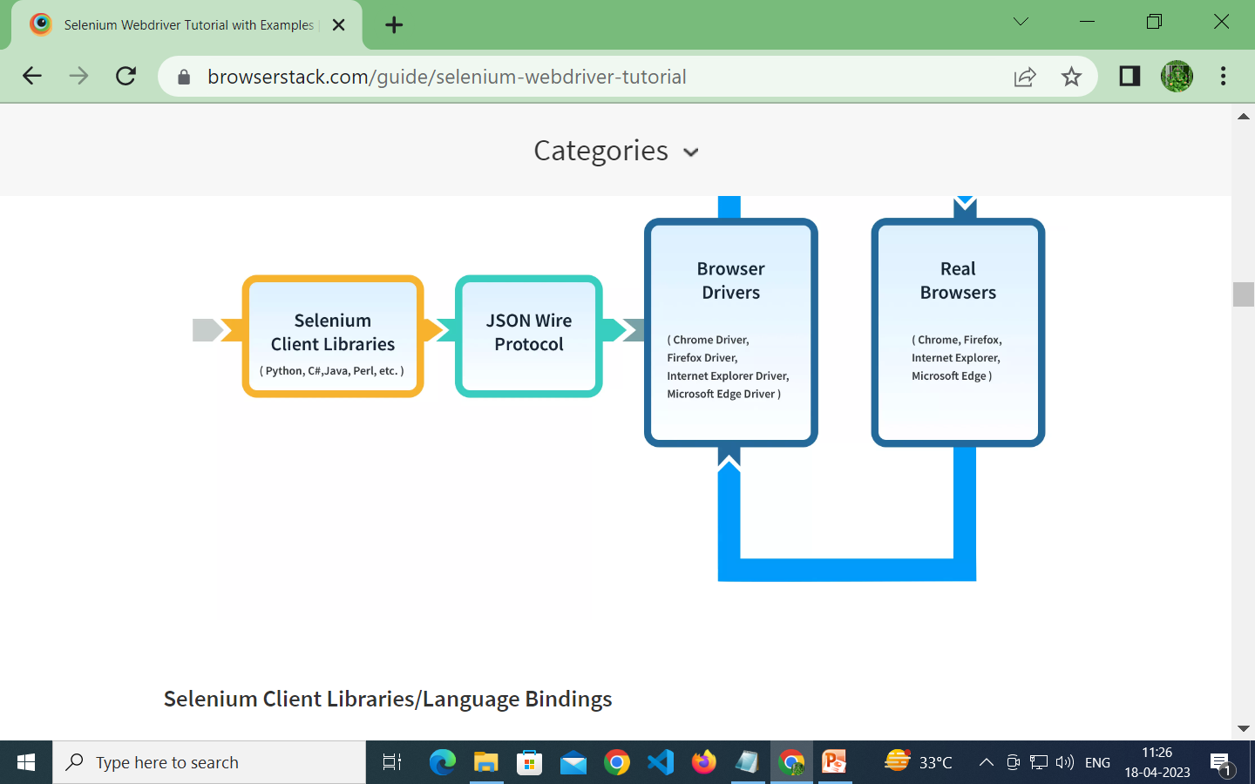

Slide 15
Web Scraping

Slide 16
What is Web Scraping?
Web scraping is a technique used to automatically extract data from websites using software or scripts.
Instead of manually copying data from a website, a program collects the data for you.

Slide 17
Why Use Web Scraping?
Data collection for analysis
Price comparison
Market research
News aggregation
Automation tasks

Slide 18
Tools Used for Web Scraping in Python
Selenium – For dynamic websites (JavaScript-based sites)
Beautiful Soup – For parsing HTML
Scrapy – Powerful scraping framework
Requests – To send HTTP requests

Slide 19
Static vs Dynamic Websites
Feature | Static Website | Dynamic Website
Content | Same for all users | Changes based on user
Database | No | Yes
Speed | Very Fast | Slightly Slower
Example | Simple Portfolio | Amazon, Facebook
Web scraping | Easy to scrape using BeautifulSoup | Need Selenium (because content loads using JavaScript)

Slide 20
Why Use Selenium for Web Scraping?
1. Handles Dynamic Websites (JavaScript Content)
2. Automates User Actions
3. Handles Login & Authentication
4. Supports Infinite Scroll Websites

Slide 21
Real-World Use Cases of Web Scraping
Job Data Collection
What is scraped?
Job title
Company name
Location
Salary
Required skills
Experience

Slide 22
From websites like:
LinkedIn
Indeed
Naukri.com
Why scrape job data?
Analyze demand for skills (Python, Selenium, etc.)
Salary trend analysis
Build job alert systems
Market research for training institutes
Example: A training institute scrapes job portals to see how many companies require Selenium + Python skills.

Slide 23
what is webdriver?
Selenium webdriver is an automated testing framework used for the validation of websites(and web applications).
Totally 6 browsers-->webdrivers download

Slide 24
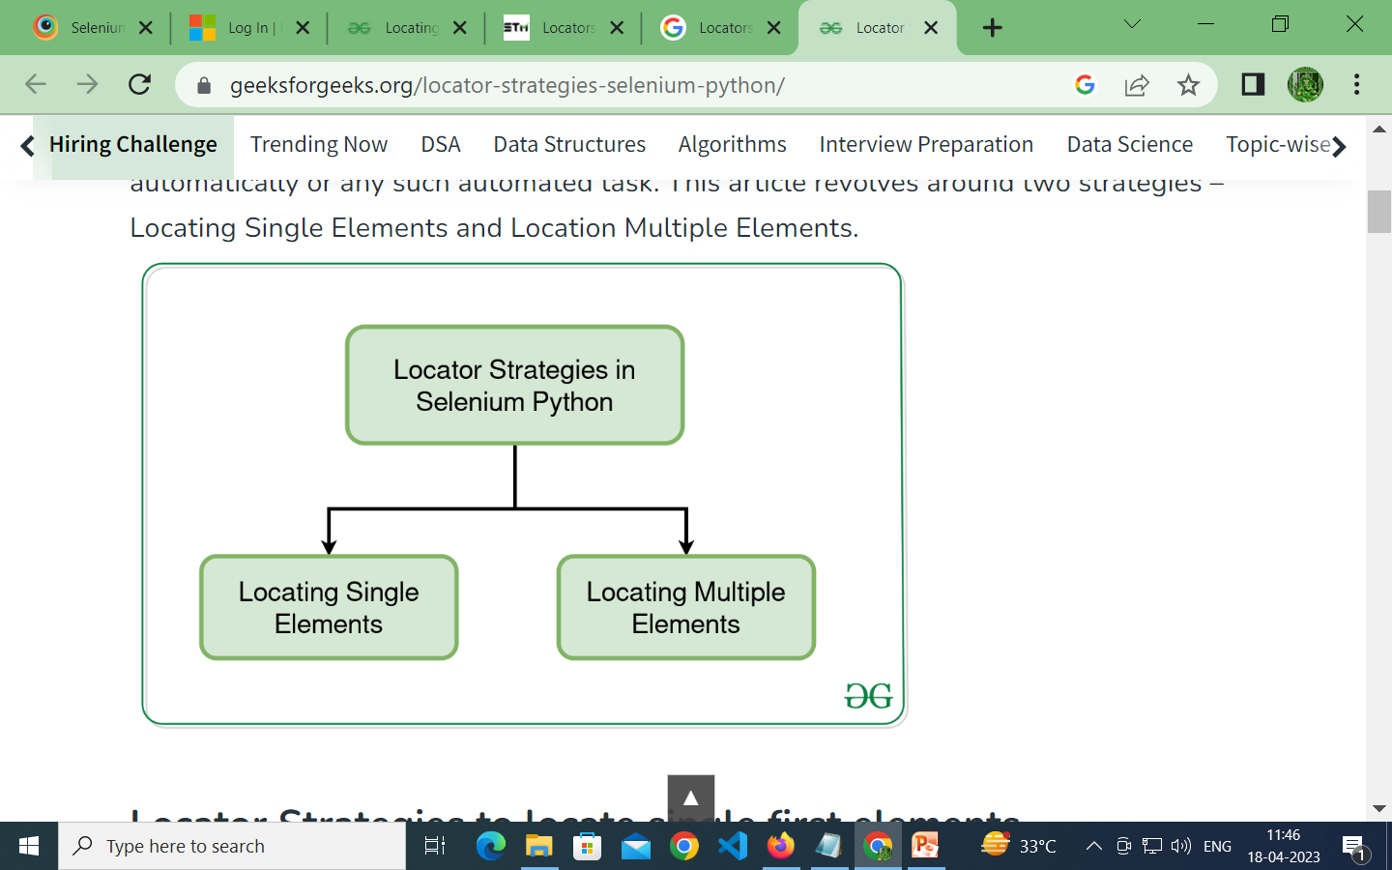
3) Selenium Locators
Locate the element on the web page via locators in selenium
Selenium have wide range of locators which helps to locate elements on a web page.

Slide 25
Locator Type | Syntax | Description / Example
1. ID | By.ID("id_value") | Finds element by its id attribute. ✅ Most reliable and fast. Example: By.ID("username")
2. Name | By.NAME("name_value") | Finds element by the name attribute. Example: By.NAME("user")
3. Class Name | By.CLASS_NAME("class_value") | Finds elements by their class attribute. Example: By.CLASS_NAME("input-field")
4. Tag Name | By.TAG_NAME("tag") | Finds elements by HTML tag, like input, button, a. Example: By.TAG_NAME("input")
5. Link Text | By.LINK_TEXT("text") | Finds links (<a> tags) by the exact visible text. Example: By.LINK_TEXT("Forgot Password")
6. Partial Link Text | By.PARTIAL_LINK_TEXT("text") | Finds links by partial match of text. Example: By.PARTIAL_LINK_TEXT("Forgot")
7. CSS Selector | By.CSS_SELECTOR("css") | Uses CSS syntax to locate elements. Very powerful and flexible. Example: By.CSS_SELECTOR("input#username") or By.CSS_SELECTOR(".btn.login")
8. XPath | By.XPATH("xpath") | Uses XML path expressions to navigate through the DOM. Extremely powerful, works when no other locator is available. Example: By.XPATH("//input[@id='username']")

Slide 26
Web elements
What is WebElement?
WebElement in Selenium represents an HTML element.
It basically represents a DOM(Document Object Model) element in a HTML document.

Slide 27
WebElement Commands in Selenium Python:
Command | Purpose | Example
send_keys() | Type text into input | element.send_keys("admin")
click() | Click on an element | element.click()
clear() | Clear text field | element.clear()
submit() | Submit a form | element.submit()
text | Get visible text | element.text
get_attribute() | Get attribute value | element.get_attribute("href")
value_of_css_property() | Get CSS style | element.value_of_css_property("color")
is_displayed() | Check if visible | element.is_displayed()
is_enabled() | Check if active | element.is_enabled()
is_selected() | Check if checked | element.is_selected()
location | Get element position | element.location
save_screenshot() | Take screenshot | driver.save_screenshot("page.png")

Slide 28
Logging into a website with Selenium
Step-by-step login flow
Go to the login page – use driver.get().
Enter your credentials – locate input fields and call .send_keys().
Submit the form – find the button and click it with .click().

Slide 29
WAITS
In Selenium, both static and dynamic waits are techniques used to control the timing of test script execution and synchronization with web elements.
They help ensure that the necessary elements are available or in the desired state before proceeding further.

Slide 30
There are two main ways to handle this:
1.time.sleep() (the brute-force way) You can just pause the script for a few seconds before scraping, but it's hit or miss.
Sometimes it's too short, sometimes way too long. Network speed, CPU load, or slow third-party scripts can all throw it off and you'll either miss elements or waste time waiting.

Slide 31
What are Web Tables?
Web Tables are like normal tables where the data is presented in a structured form using rows and columns.
The only difference is that they are displayed on the web with the help of HTML code.
<table> is the HTML tag that is used to define a web table.
While <th> is used for defining the header of the table, <tr> and <td> tags are used for defining rows and columns respectively for the web table.

Slide 32
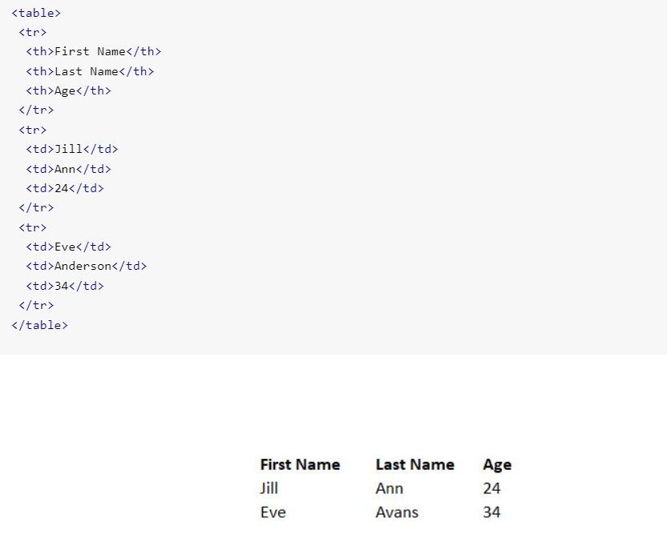
Example

Slide 33
Types of Web Tables
Depending on the data in the table, web tables can be classified as Static web tables and Dynamic web tables.
1. Static Web Tables
These tables have fixed data that remains unchanged throughout. Due to the static nature of their content, they are called Static web tables.

Slide 34
2. Dynamic Web Tables
These tables have data that changes over time, and hence the number of rows and columns might also change depending upon the data shifts.
Due to the dynamic nature of their content, they are called Dynamic web tables.

Slide 35
1.To calculate the total number of rows:
this method returns a list, we can obtain the row count with the help of len method.
2.To calculate the total number of columns:
this method returns a list, we can obtain the row count with the help of len method.
We have to fix a row number before calculating the column count with <td>.
If we set row 1, we have to use <th> for the columns.
For any other row except 1, we have to use <td>.

Slide 36
3.To get the headers in a table:
We have to iterate through row number 1, then move to <th>.
Once we get hold of the first row, we shall use the text method to get all the table headers.
4.To get all the cell values of a particular row:
We have to iterate through the columns of a particular row number [greater than 1], having <td> tag.
Once we get hold of all the values in that particular row, we shall use the text method to get all the cell data.

Slide 37
Image
What are broken images on a Web Page?
There are cases where an image on the web page does not load properly, and we see "Failed to load image" or similar error messages.
In such cases, the image is either corrupt or the image is not at the specified path.
A broken image on a web page is a link that is associated with the image, and the link is not working.

Slide 38
Why should you check for broken images?
Here are the two major reasons for checking for broken images on websites:
Broken images on a website hamper the end-user experience, which could negatively impact the growth of the product.
Images are an essential part of the content marketing strategy.
However, broken images could create SEO issues.
Images with missing ALT tags and broken internal images are problematic from an SEO point of view and should be looked into on a high priority.

Slide 39
How Do You Handle a Broken Image in Selenium?
broken image is a link that does not show up as a picture.
By clicking on it, the end-user is redirected to a distorted picture and a 404 error notification.
This error means that the image is not loading properly.
There can be several reasons for this like incorrect image format or URL,or server issues.

Slide 40
Steps for fixing broken images in Selenium:
Open the browser and find all the images using <img> attribute with the find_elements method
Iterate on each image
Use the get method on the image and retrieve its status code
Assert whether the status code is 200, if it is 200, it is fine, if not, then it is a broken image.
Broken image-->img tag & src attribute

Slide 41
There are different HTTP status codes, and a few of them are as below:
200 – Valid Link,image/success
301/302 - Page redirection temporary/permanent
404 – Page not found
400 – Bad request
401 – Unauthorized
500 – Internal Server Error
We will be using these HTTP codes in our tests to ensure that the link is valid or not.

Slide 42
To extract image
import selenium from selenium import webdriver from selenium.webdriver.common.by import By import time as t a=webdriver.Chrome() a.get("https://www.amazon.in/") t.sleep(5) images = a.find_elements(By.TAG_NAME, "img") for img in images: print(img.get_attribute("src"))

Slide 43
from selenium import webdriver from selenium.webdriver.common.by import By import requests driver=webdriver.Firefox() driver.get("http://demo.guru99.com/test/newtours/") driver.maximize_window() all_links = driver.find_elements(By.CSS_SELECTOR,"img") #(iterate/loop) check each link if it is broken or not for link in all_links: #extract url from href attribute url = link.get_attribute('src') #send request to the url and get the result result = requests.head(url) #if status code is not 200 then print the url (customize the if condition according to the need) if result.status_code != 200: print(url, result.status_code)

Slide 44
To create csv file
import csv
data = ["Python", "Selenium", "Web Scraping"] with open("C:\\Users\\manojana\\OneDrive\\Desktop\\testing.csv", "w", newline="") as file: //to create file writer = csv.writer(file)//write a file writer.writerow(["Technology"])//column name for item in data: writer.writerow([item])//writing data

Slide 45
Challenges in Web Scraping
Dynamic Website Content
Website Structure Changes
CAPTCHA & Anti-Bot Protection
Login & Authentication
IP Blocking & Rate Limiting
Data Quality Issues

Slide 46
How to collect data from real time websites
If I use linked in
Data Extracted
Job Title
Company Name
Location
Required Skills
Experience Level
Job Link

Slide 47
Tools & Technologies
Python
Selenium WebDriver
Chrome Browser
CSV File Storage

Slide 48
Project Workflow
1. Open job website
2. Search for "Python Developer"
3. Scroll job listings
4. Extract job details
5. Store data into CSV file
6. Close browser

Slide 49
Web Scraping Architecture
User Script (Python)
↓
Selenium WebDriver
↓
Browser Driver (ChromeDriver)
↓
Web Browser
↓
Website Server
↓
HTML Data Returned
↓
Data Extraction & Storage

Slide 50
Login Automation using Selenium
Automates user authentication process
Enters username and password automatically
Handles secured web pages
Maintains session after login
Enables scraping of protected data
Used in job portals like Naukri.com.

Slide 51
Data Extraction Process
Elements identified using locators
.text extracts visible data
Loops collect multiple records
Data stored for analysis

Slide 52
Role of CSV in Web Scraping
Why CSV is Used in Web Scraping
Lightweight file format
Easy to open in Excel
Stores structured data
Suitable for large datasets
Supports data analysis tools

Slide 53
Limitations of Selenium
Slower than API scraping
Requires browser installation
High memory usage
Website layout changes break scripts
CAPTCHA handling is difficult

